Slide 1
The Gift of Scripture
Introductory Session

Slide 2
Opening Prayer
God our Father, we thank you for your presence with us, and we thank you for the opportunity to reflect on the gift of our faith and to explore the gift of the Scriptures.
Give us the grace to truly listen to you and to listen to one another. May we allow your Spirit to lead us and guide us.
Speak your Word deep within our hearts and direct us to grow in love for you and for one another.
May this time together be an experience of faith, hope and love. We ask this in the power of the Spirit, and through Jesus Christ our Lord. Amen

Slide 3
Reading
Ephesians 3:14-21
For this reason, I kneel before the Father, from whom every family in heaven and on earth derives its name. I pray that out of his glorious riches he may strengthen you with power through his Spirit in your inner being, so that Christ may dwell in your hearts through faith.
And I pray that you, being rooted and established in love, may have power, together with all the Lord’s holy people, to grasp how wide and long and high and deep is the love of Christ, and to know this love that surpasses knowledge – that you may be filled to the measure of all the fullness of God.
Now to him who is able to do immeasurably more than all we ask or imagine, according to his power that is at work within us, to him be glory in the church and in Christ Jesus throughout all generations, for ever and ever! Amen.

Slide 4
Questions
What was the most useful thing for you from the document?
What did you find challenging from the document?
What do you understand of the relationship of Scripture and Tradition?

Slide 5
For our next meeting:
We will be exploring the section on ‘Understanding the Word of God’
https://www.liturgyoffice.org.uk/Resources/Scripture/GoS.pdf
Read paragraphs 13 – 23.

Slide 6
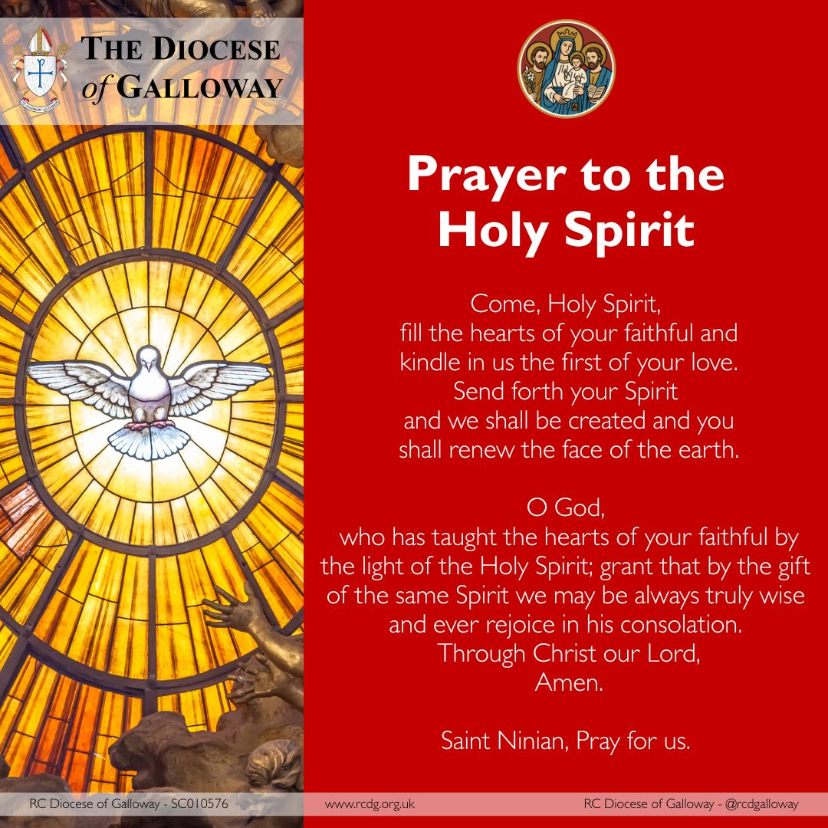
Closing Prayer

Slide 7
The Gift of Scripture
Session One:
Understanding the Word of God

Slide 8
Setting the Scene
Listen to or sing the hymn “Our God Reigns” might be appropriate, or “Seek ye First.”

Slide 9
Opening Prayer
Dear Father,
As we open Your Word today, we quiet the noise and distractions of the world around us. Please calm our minds and still our hearts. Grant us spiritual ears to hear Your voice and open eyes to seek Your truth. Speak, Lord, for Your servants are listening. Transform our lives by Your Word, and give us grace and courage to follow your will.
Through Christ our Lord
Amen

Slide 10
Reading
Romans 10:14-18
How then will they call on him in whom they have not believed? And how are they to believe in him of whom they have never heard? And how are they to hear without someone preaching? And how are they to preach unless they are sent? As it is written, “How beautiful are the feet of those who preach the good news!”
But they have not all obeyed the gospel. For Isaiah says, “Lord, who has believed what he has heard from us?” So faith comes from hearing, and hearing through the word of Christ. But I ask, have they not heard? Indeed they have, for “Their voice has gone out to all the earth, and their words to the ends of the world.”

Slide 11
Questions
What was the most useful thing for you from the document?
What did you find challenging from the document?
What do you understand by the truth of Scripture and the Inspiration of Scripture?

Slide 12
Reflection
Reflect on the invitation of Christ to know Him through His Word as shown in The Light of the World painting by William Holman Hunt, perhaps with the quote from Psalms ´your Word is a lamp for my feet a light for my path’ (Ps 119:105; and/or Revelation 3:20 ´Behold I stand at the door and knock. If anyone heard my voice and opens the door then I will enter his house and dine with him and he with me.’
Useful information on the painting can be found at https://www.stpauls.co.uk/light-of-world-by-william-holman-hunt

Slide 13
For our next meeting:
We will be exploring the section on ‘Reading the Old Testament
https://www.liturgyoffice.org.uk/Resources/Scripture/GoS.pdf
Read paragraphs 24 – 41.

Slide 14
Closing Prayer

Slide 15
The Gift of Scripture
Session Two:
Reading the
Old Testament

Slide 16
Setting the Scene
One of Rembrandt van Rijn’s Old Testament paintings, such as ‘The Angel stopping Abraham from sacrificing Isaac’ (1635) could be put up on the screen of a laptop for the duration of the session. The Angel Stopping Abraham from Sacrificing Isaac by REMBRANDT Harmenszoon van Rijn.This artwork is there to illustrate the connection between Christ’s sacrifice and the many parallels between the Old and the New Covenant, as well as the history of reception of the Bible throughout two millennia of European history.
Traditional Jewish music arranged for the 10-stringed lyre of the Levites may be used in the background, to set the tone at the start of the session or during quiet times.
https://www.youtube.com/watch?v=9GpuYfuaM2Y (this is all instrumental).

Slide 17
Opening Prayer
“O Lord Jesus Christ, open the eyes of my heart, that I may hear your word and understand and do your will, for I am a sojourner upon the earth.
Hide not your commandments from me, but open my eyes, that I may perceive the wonders of your law. Speak unto me the hidden secret things of your wisdom.
On You I set my hope, O my God, that You will enlighten my mind and understanding with the light of your knowledge, not only to cherish those things which are written, but do them; that in reading lives and sayings of the saints I may not sin, but that such may serve for my restoration, enlightenment and sanctification, for the salvation of my soul, and the inheritance of life everlasting.
For You are the enlightenment of those who lie in darkness, and from You comes every good deed and every gift. Amen.”
St John Chrysostom (4th century., Bishop of Constantinople).

Slide 18
Reading
Psalm 119:129-136
Your statutes are wonderful;
therefore I obey them.
The unfolding of your words gives light;
it gives understanding to the simple.
I open my mouth and pant,
longing for your commands.
Turn to me and have mercy on me,
as you always do to those who love your name.
Direct my footsteps according to your word;
let no sin rule over me.
Redeem me from human oppression,
that I may obey your precepts.
Make your face shine on your servant
and teach me your decrees.
Streams of tears flow from my eyes,
for your law is not obeyed.

Slide 19
Questions
What was the most useful thing for you from the document?
What did you find challenging from the document?
How might we engage more deeply with the Old Testament?

Slide 20
For our next meeting:
We will be exploring the section on ‘Reading the New Testament
https://www.liturgyoffice.org.uk/Resources/Scripture/GoS.pdf
Read paragraphs 42 – 69

Slide 21
Closing Prayer

Slide 22
The Gift of Scripture
Session Three:
Reading the
New Testament

Slide 23
Setting the Scene
Listen to music ‘On the nature of Daylight’ by Max Richter
https://www.bing.com/videos/riverview/relatedvideo?q=you+tube+music+on+the+nature+of+daylight+by+max+richter&mid=568CA49F53D874916BA7568CA49F53D874916BA7&churl=https://www.youtube.com/channel/UCOQ_j8Qg4-p0lGKBpXYENbg&FORM=VIRE
As this plays, display a few images of the sculpture ‘In the Beginning’, also known as ‘The Christ Child’, by Mike Chapman. Christ Child (sculpture) – Wikipedia
The sculpture can be found outside the entrance of St Martin-in-the-Fields Church in Trafalgar Square, London. It was created for the new millennium. It shows a life-size newborn baby emerging from a massive 4.5-tonne block of Portland stone. It is carved with the biblical quote, ‘In the beginning was the Word, and the Word became flesh and lived among us’ (John 1:14).”

Slide 24
Opening Prayer
Heavenly Father, You who spoke in times past through the prophets, have brought Your word to its fullness in Your Son, Jesus Christ.
As we open the pages of the New Testament, open our minds and hearts to hear Him anew. Grant us the grace to encounter Him as He is—the living Word, our Teacher, Saviour, and Lord.
Send Your Holy Spirit upon us, that we may read these sacred texts not merely as history, but as a living encounter that shapes our daily lives. Help us to hear the Gospel with the courage of the Apostles, the devotion of the early Church, and the living hope of those who await Your Kingdom. We ask this through Christ our Lord, Amen.

Slide 25
Reading
Gospel
John 1:1-5, 9-14
‘The Word became flesh and dwelt among us.’
In the beginning was the Word, and the Word was with God, and the Word was God. He was in the beginning with God. All things were made through him, and without him was not any thing made that was made. In him was life, and the life was the light of men. The light shines in the darkness, and the darkness has not overcome it.
The true light, which gives light to everyone, was coming into the world. He was in the world, and the world was made through him, yet the world did not know him. He came to his own, and his own people did not receive him. But to all who did receive him, who believed in his name, he gave the right to become children of God, who were born, not of blood nor of the will of the flesh nor of the will of man, but of God.
And the Word became flesh and dwelt among us, and we have seen his glory, glory as of the Only Begotten from the Father, full of grace and truth.

Slide 26
Questions
What was the most useful thing for you from the document?
What did you find challenging from the document?
How might we be inspired to make more use of the New Testament?

Slide 27
For our next meeting:
We will be exploring the section on ‘Living the Word of God’
https://www.liturgyoffice.org.uk/Resources/Scripture/GoS.pdf
Read paragraphs 70 – 84

Slide 28
Closing Prayer

Slide 29
The Gift of Scripture
Session Four:
Living the Word of God

Slide 30
Setting the Scene
Listen to or sing the hymn ‘Christ be our Light’.
Supper at Emmaus (Caravaggio, London) - Wikipedia
You may also wish to display the following image:

Slide 31
Opening Prayer
Risen One, like those disciples on the road to Emmaus, we struggle to recognize you in the everyday journey of our lives.
As you opened the scriptures to the disciples and taught them everything, open our eyes to behold you in your Word.
Open our eyes, Light of the World, to your work of transformation in and around us. We thank you that you travel with us in our joys and our concerns. Amen

Slide 32
Reading
Luke 24:13–35 — The Road to Emmaus
Now that same day two of them were going to a village called Emmaus, about seven miles from Jerusalem. They were talking with each other about everything that had happened. As they talked and discussed these things with each other, Jesus himself came up and walked along with them; but they were kept from recognizing him.
He asked them, “What are you discussing together as you walk along? ”They stood still, their faces downcast. One of them, named Cleopas, asked him, “Are you the only one visiting Jerusalem who does not know the things that have happened there in these days?” “What things?” he asked. “About Jesus of Nazareth,” they replied. “He was a prophet, powerful in word and deed before God and all the people. The chief priests and our rulers handed him over to be sentenced to death, and they crucified him; but we had hoped that he was the one who was going to redeem Israel. And what is more, it is the third day since all this took place. In addition, some of our women amazed us. They went to the tomb early this morning but didn’t find his body. They came and told us that they had seen a vision of angels, who said he was alive. Then some of our companions went to the tomb and found it just as the women had said, but they did not see Jesus.”
He said to them, “How foolish you are, and how slow to believe all that the prophets have spoken! Did not the Messiah have to suffer these things and then enter his glory?” And beginning with Moses and all the Prophets, he explained to them what was said in all the Scriptures concerning himself.
As they approached the village to which they were going, Jesus continued on as if he were going farther. But they urged him strongly, “Stay with us, for it is nearly evening; the day is almost over.” So he went in to stay with them.
When he was at the table with them, he took bread, gave thanks, broke it and began to give it to them. Then their eyes were opened and they recognized him, and he disappeared from their sight. They asked each other, “Were not our hearts burning within us while he talked with us on the road and opened the Scriptures to us?”
They got up and returned at once to Jerusalem. There they found the Eleven and those with them, assembled together and saying, “It is true! The Lord has risen and has appeared to Simon.” Then the two told what had happened on the way, and how Jesus was recognized by them when he broke the bread.

Slide 33
Questions
What was the most useful thing for you from the document?
What did you find challenging from the document?
What might we do to encourage our parishes to promote greater use of the Scriptures in daily life?

Slide 34
Where to now?
Possible next steps? Some suggestions:
Come and Pray A monthly Lectio Divina gathering.
Come and Explore A parish Scripture/Bible group.
Come and Serve An opportunity to put the Gospel into action through parish or outreach / community service.
What practical step can we take which might support our journey of discipleship?

Slide 35
Closing Prayer

